Slide 1

MINI PROJECT
On
FACE RECOGNITION USING DEEP LEARNING
Group Members:
A.NITHIN KUMAR -195U1A0508
B.ARAVIND REDDY -195U1A0515
A.THANUJA -195U1A0506
P.CHANDRA VIKAS -17M31A0546
Project Guide:
Mr.V.BASHA
Assistant Professor
Department of CSE

Slide 2
ABSTRACT:
In this project we show how easy it is to detect faces and identify gender along with age with the help of CNN(Convolutional Neural Networks) and OpenCV. Using these fields of Artificial Intelligence, we can reduce the use of hardware components and complexities in this project. For the output to be determined even with multiple parameters we use pre-trained model that is caffe model along with OpenCV. The proposed model can be used in surveillance purposes or in medical purposes.

Slide 3
PROBLEM STATEMENT AND DESCRIPTION:
It is challenging to determine an accurate age from a single shot due to factors such as cosmetics, environmental lights, impediments, and facial expressions.
The main goal of this project is to detect the age and gender of the given image. This can be done using deep learning in OpenCV. The goal here is to create a program that will predict the gender and age of the person using an image.

Slide 4
AIM OF THE PROJECT:
The main aim is to detect the age and gender of a person by using deep learning in opencv.

Slide 5
OBJECTIVE:
Deep learning’s neural networks forms the basis for the entire model and then entire decision making process is done by the neurons of the neural network.
The main objective is to determine the parameters like the age, gender of the person by using the model being developed.

Slide 6
SCOPE:
The output prediction depends on the present inputs for those algorithms. Deep Learning improves the overall performance and the efficiency of the model which has to detect characteristics of the person like age and gender by developing a neural network. The model being developed can be used for surveillance purposes.

Slide 7
EXISTING SYSTEM:
Many early methods in age and gender detection were handcrafted, focusing on manually engineering the facial features from the face. To mention a few, in 1999, Kwon and Lobo developed the very first method for age estimation focusing on geometric features of the face that determine the ratios among different dimensions of facial features. These geometric features separate babies from adult successfully but are incapable of distinguishing between young adult and senior adult.

Slide 8
PROPOSED METHODOLOGY:
In our proposed model we use CNN and Opencv for facial recognition. This proposed model can detect faces, divide into Male/Female based facial features, divide an image with face of a person into one of 8 age ranges.
Convolutional neural networks (CNN): There are various neural networks available which can be used as per the requirement or inputs being given.
They have 3 main layers are input layer, hidden layer(s) and the output layer.
Each layer has large number of neurons where each is associated with a certain value of weights.

Slide 9
HARDWARE REQUIREMENTS:
RAM: 8GB
CPU: intel core i5-4200u cpu @ 1.60ghz
System: laptop/desktop
System architecture: 64-bit operating system, x64-based processor

Slide 10
SOFTWARE REQUIREMENTS:
Operating system: Windows 10
Anaconda
Jupyter notebook

Slide 11
DESIGN:
A typical neural network will have an input layer, hidden layers, and an output layer. CNNs are inspired by the architecture of the brain. Just like a neuron in the brain processes and transmits information throughout the body, artificial neurons or nodes in CNNs take inputs, processes them and sends the result as output. The image is fed as input. The input layer accepts the image pixels as input in the form of arrays. In CNNs, there could be multiple hidden layers, which perform feature extraction from the image by doing calculations. This could include convolution, pooling, rectified linear units, and fully connected layers.

Slide 12
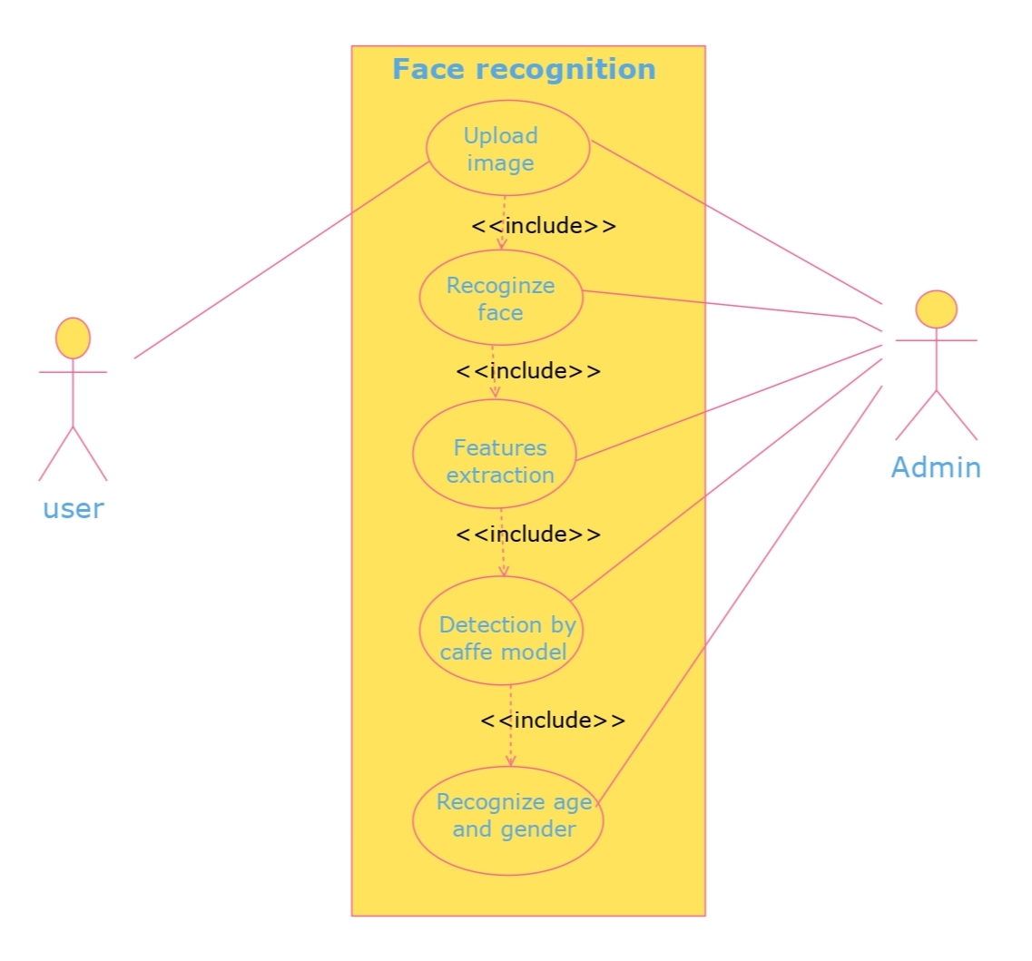
Use Case:
DESIGN CONCEPTS:

Slide 13
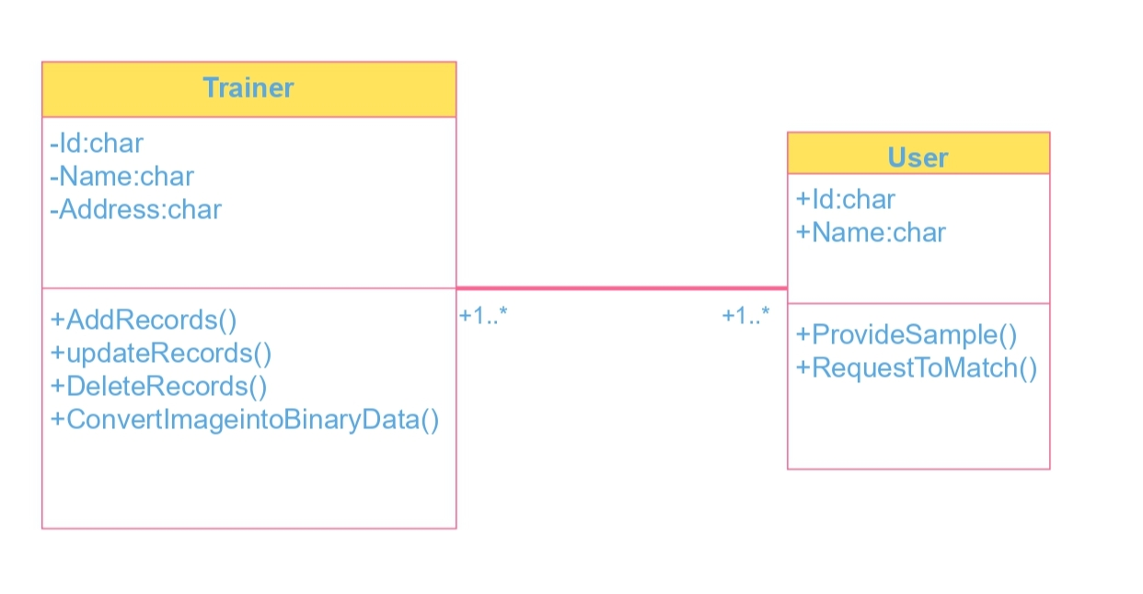
Class diagram:

Slide 14
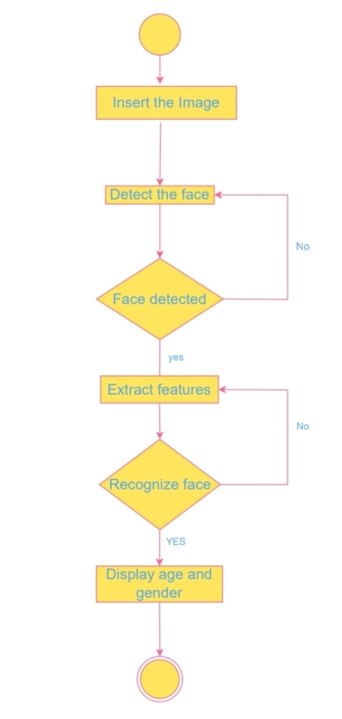
ACTIVITY DIAGRAM:

Slide 15
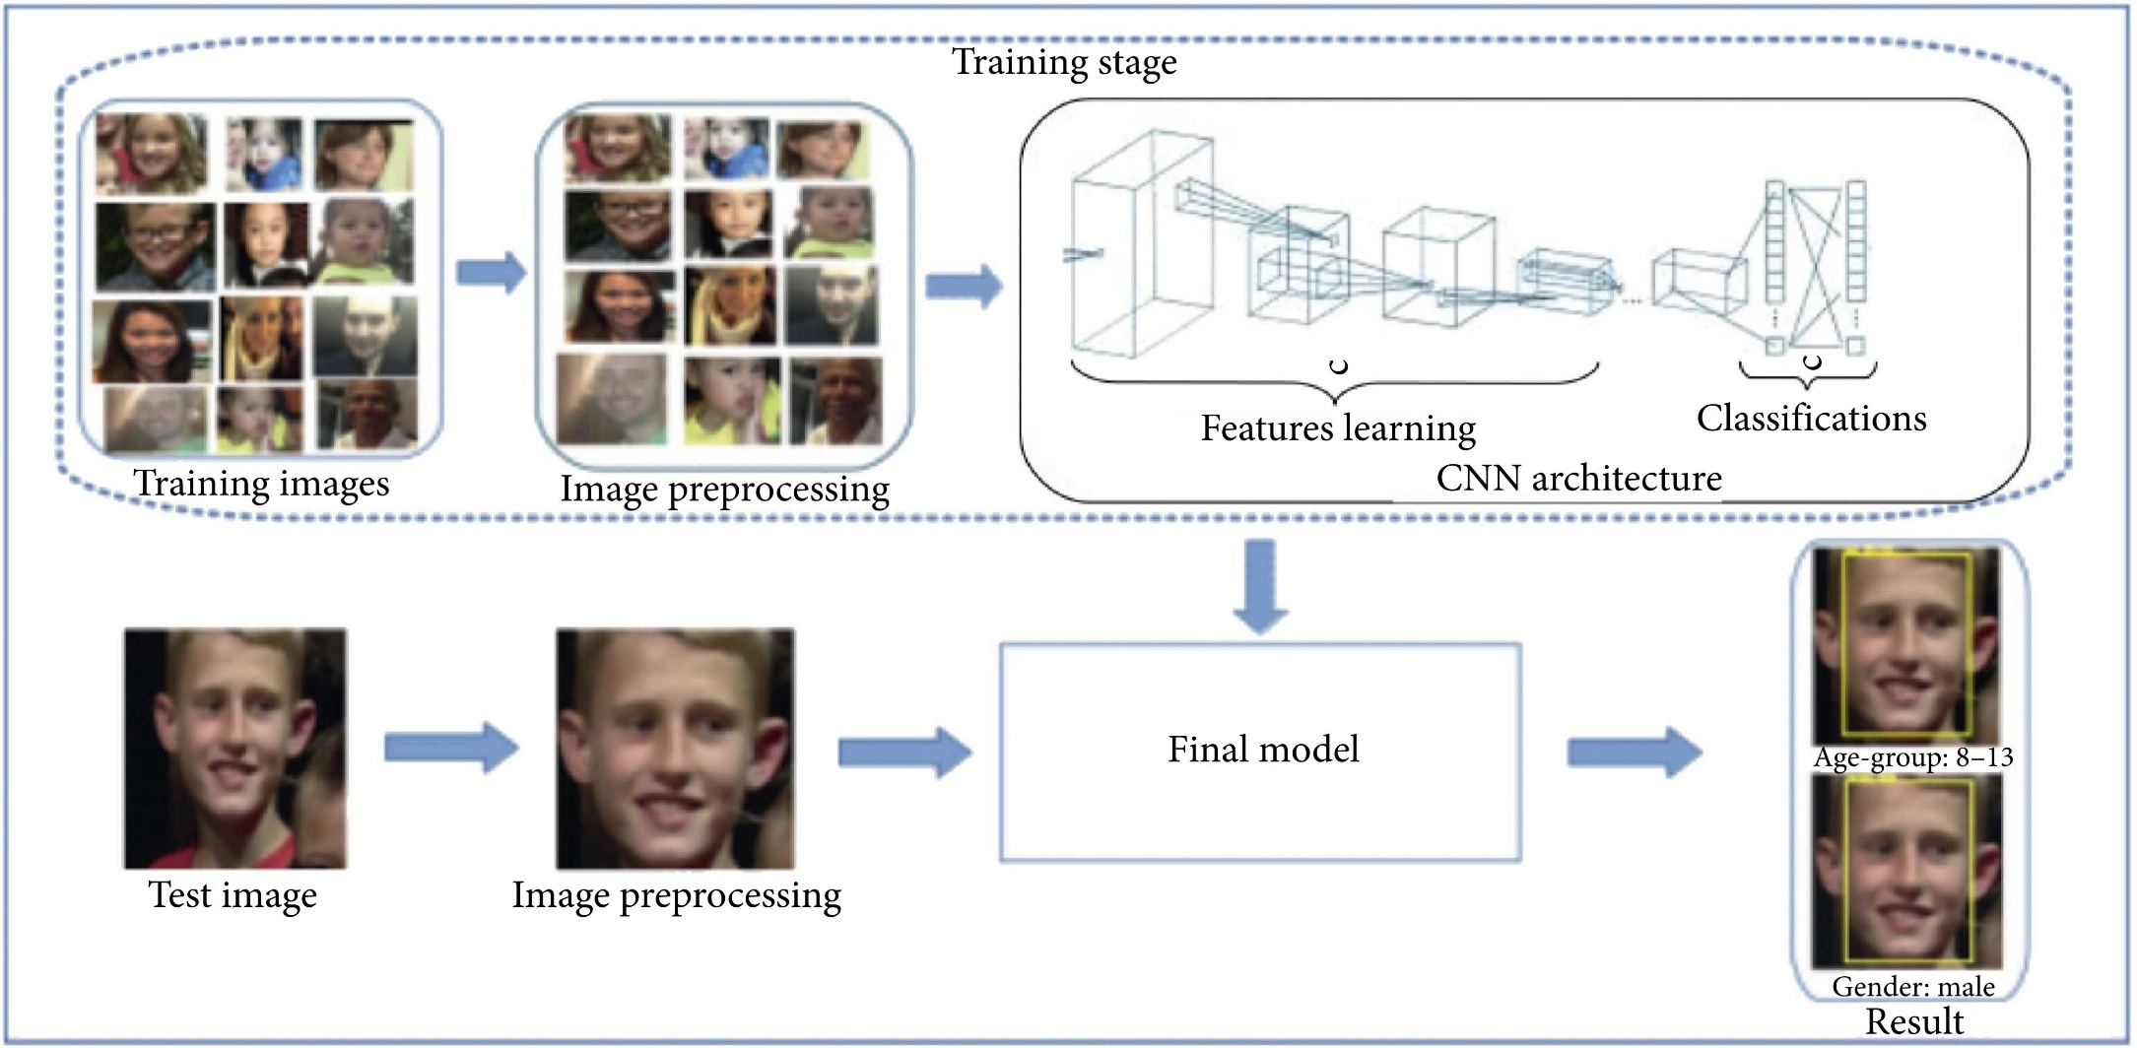
CONCEPTUAL DESIGN:

Slide 16
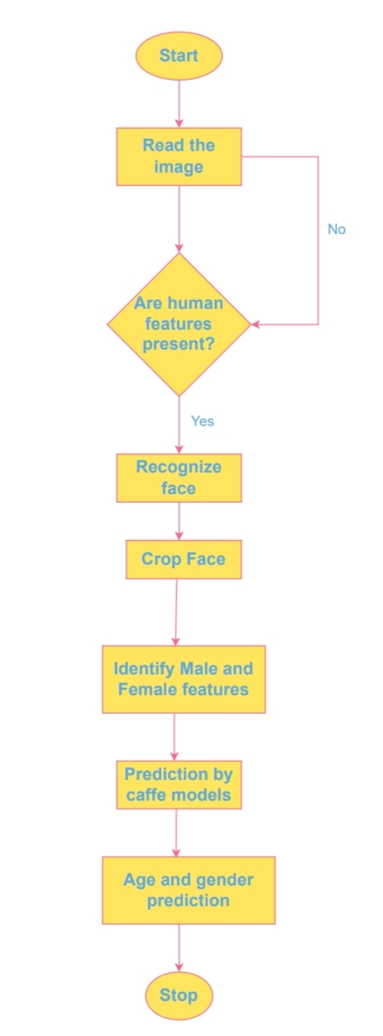
LOGICAL DESIGN:

Slide 17
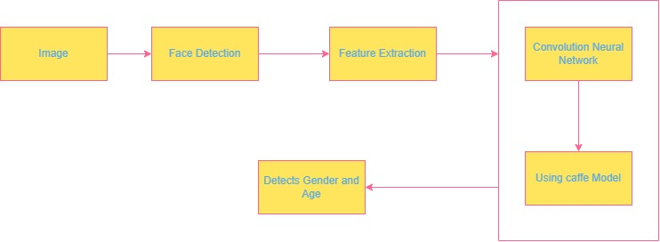

ARCHITECTURAL DESIGN:

Slide 18
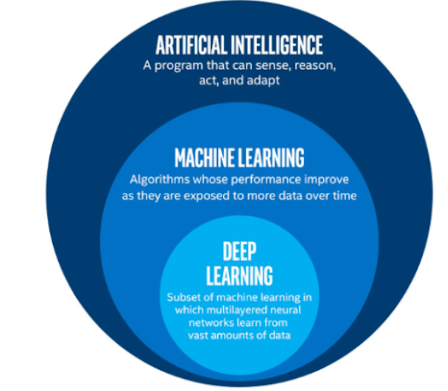
ALGORITHM DESIGN:
Deep learning: Deep learning is a type of machine learning and artificial intelligence (AI) that imitates the way humans gain certain types of knowledge. Deep learning is an important element of data science, which includes statistics and predictive modeling. It is extremely beneficial to data scientists who are tasked with collecting, analyzing and interpreting large amounts of data; deep learning makes this process fAster and easier.

Slide 19
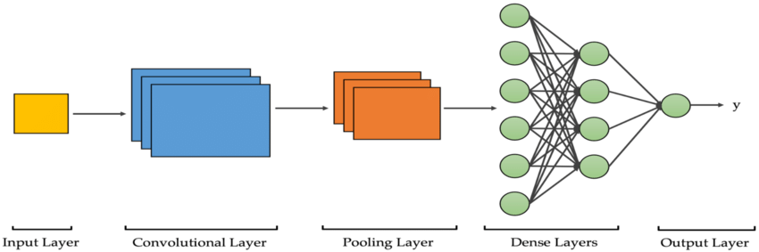
CNN: Within Deep Learning, a Convolutional Neural Network or CNN is a type of artificial neural network, which is widely used for image/object recognition and classification. Deep Learning thus recognizes objects in an image by using a CNN. CNNs are playing a major role in diverse tasks/functions like image processing problems, computer vision tasks like localization and segmentation, video analysis, to recognize obstacles in self-driving cars, as well as speech recognition in natural language processing. As CNNs are playing a significant role in these fast-growing and emerging areas, they are very popular in Deep Learning.

Slide 20

OpenCV: OpenCV is the huge open-source library for the computer vision, machine learning, and image processing and now it plays a major role in real-time operation which is very important in today’s systems. By using it, one can process images and videos to identify objects, faces, or even handwriting of a human. When it integrated with various libraries, such as NumPy, python is capable of processing the OpenCV array structure for analysis. To Identify image pattern and its various features we use vector space and perform mathematical operations on these features.

Slide 21
MODULE DESIGN AND SPECIFICATIONS:
Data Collection:
gender_net.caffemodel:it is the pre-trained model weights for gender detection
deploy_gender.prototxt: is the model architecture for the gender detection model (a plain text file with a JSON-like structure containing all the neural network layer’s definitions).
age_net.caffemodel: It is the pre-trained model weights for age detection.

Slide 22
deploy_age.prototxt: is the model architecture for the age detection model (a plain text file with a JSON-like structure containing all the neural network layer’s definitions).
res10_300x300_ssd_iter_140000_fp16.caffemodel: The pre-trained model weights for face detection.
deploy.prototxt.txt: This is the model architecture for the face detection model.
Importing Libraries: OpenCV and numpy.

Slide 23
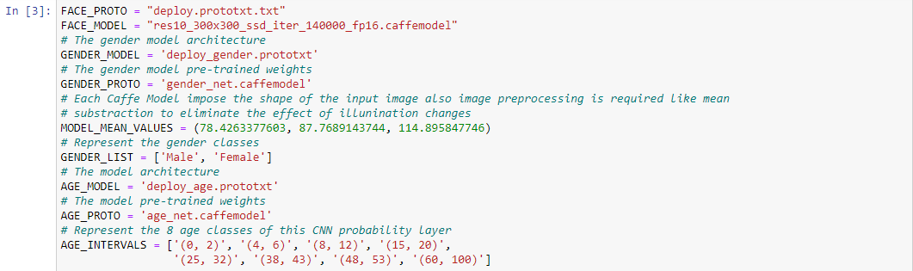
CODING PHASE
Importing Libraries:
Defining the variables of weights and architectures for face, age, and gender detection models:

Slide 24
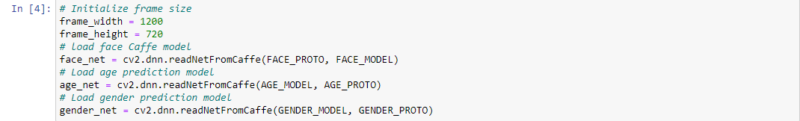
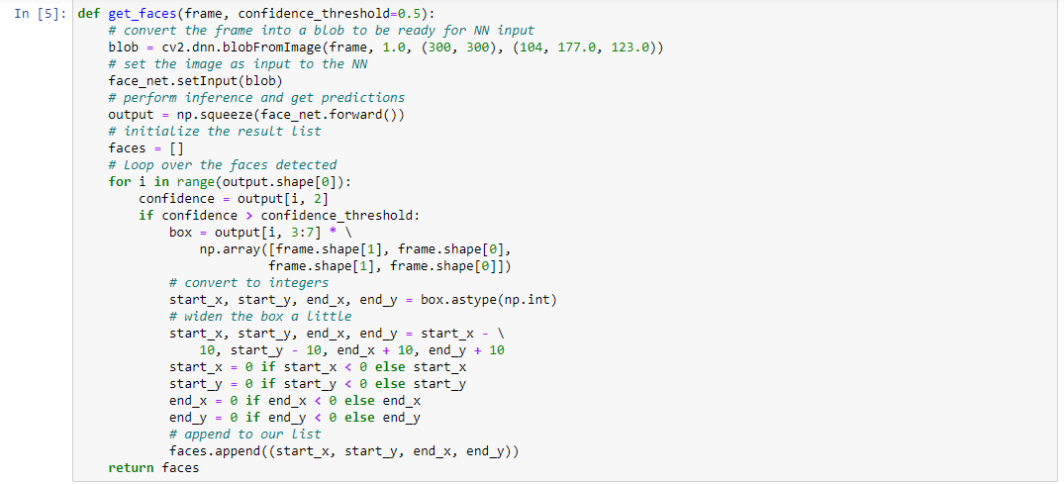
Loading the models:
Face detection:

Slide 25
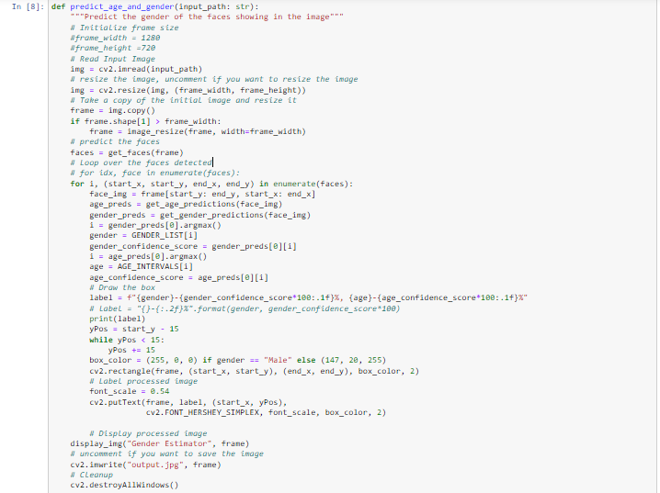
Function for predicting age and gender:

Slide 26
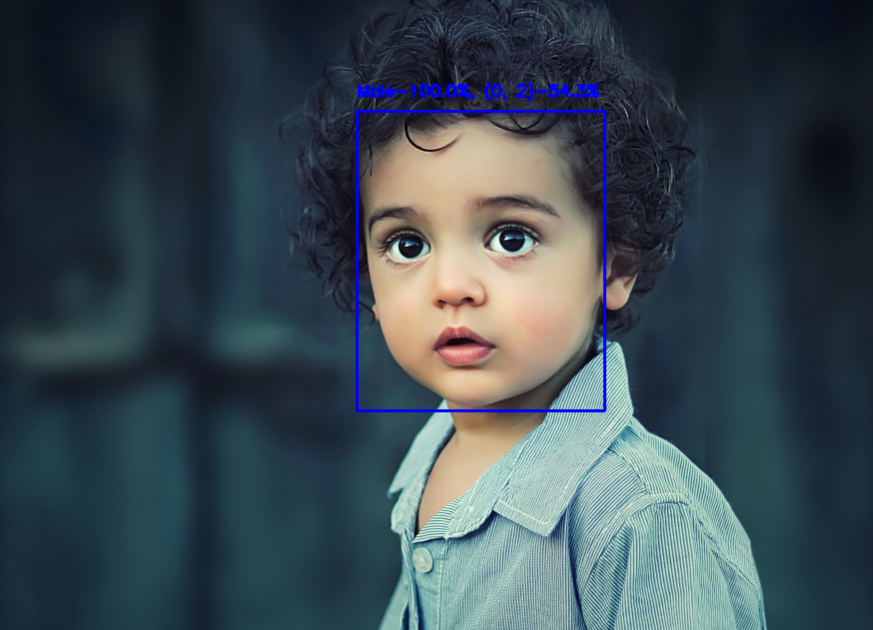
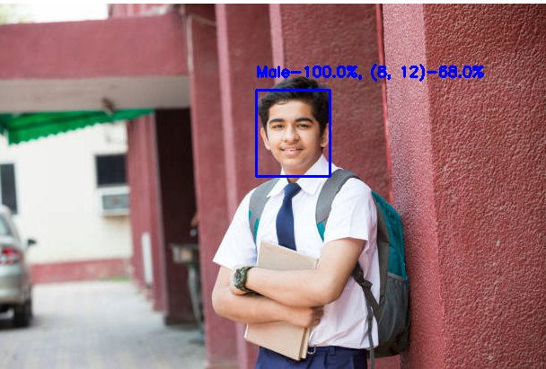
RESULT

Slide 27
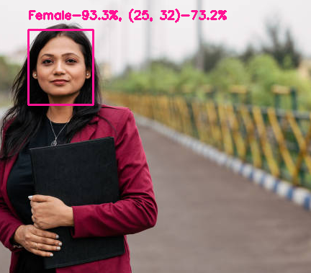
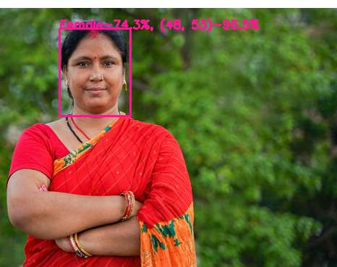
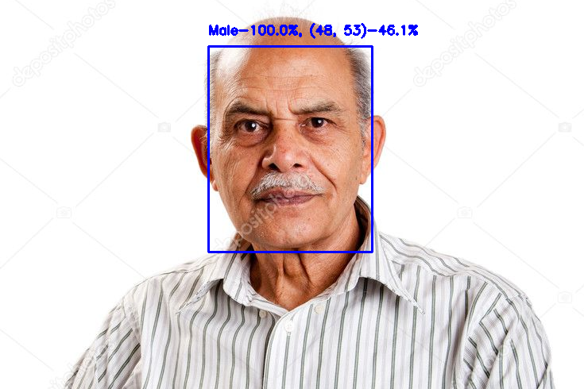

Slide 28
APPLICATIONS:
The project can be developed into a web application or a mobile application such that it is easily accessible.
In public places- using sensors this can be used in public places like restaurants, ATM places, shops such then when a theft happens the scope of finding the person could be much more easy.
Enhancing this project to detect multiple individuals-this project can be enhanced such it can estimate age and gender even for a group of individuals in the image. This model does detect the face of individuals in a group but cannot give the accurate age and gender estimation.

Slide 29
CONCLUSION:
The age and gender detection using OpenCV will be very beneficial in authorization purposes, medical purposes or surveillance purposes. The CNN and OpenCV combined can give great results. The OIU-Adience dataset used in the project gives result with greater accuracy. We used protocol buffer and caffee model files. This project shows how OpenCV can be used for face detection without any other complicated process.

Slide 30
REFERENCE:
Van der Aalst, W. (2016). Data Science in Action. Process Mining, 3– 23. doi:10.1007/978-3-662-49851-4_1 .
Sanchez-Pinto LN, Luo Y, Churpek MM, Big Data and Data Science in Critical Care, CHEST (2018), doi: 10.1016/j.chest.2018.04.037 .
Duan, Y., Edwards, J. S., & Dwivedi, Y. K. (2019). Artificial intelligence for decision making in the era of Big Data – evolution, challenges and research agenda. International Journal of Information Management, 48, 63– 71.doi:10.1016/j.ijinfomgt.2019.01.021

Slide 31
THANK YOU

